Slide 1

20104079 Kalpesh Chavan
20104111 Siddhant Darekar
20104082 Ankit Awade
Project Guide
Prof. Neha Deshmukh

Slide 2

Topic : House Price Prediction
- Mini Project (2B)

Slide 3

Contents
◆ Introduction
◆ Objectives
◆ Scope
◆ Literature Survey
◆ Proposed System
◆ Project Outcomes
◆ Algorithm Used
◆ Block Diagram
◆ Use Case Diagram
◆ Technology Stack
◆ Suggestions in Review 1
◆ Result and Discussion
◆ Conclusion and Future Scope
◆ References

Slide 4

1. Introduction
• Problem Identified:
- Incorrect House Prices
- Property Condition
- Neighborhood Factors
- Illegal Documents
• Solution Proposed:
- The convenience
- Access anytime (24/7)
- Genuine House Prices
- Cost Saving
- Legal Documentation

Slide 5

2. Objectives
• To provide a better and fast way of performing
operations regarding house price
• To provide proper house price to the customers
• To eliminate need of real estate agent to gain
information regarding house prices
• To provide best price to user without getting
cheated
• To enable user to search home as per the budget

Slide 6

3. Scope
• The website will collect real-time data related to house
prices in given area
• The data would be obtained from local government,
property agents and other relevant sources
• The website will analyze the collected data and use it to
predict house prices in given areas
• The website should have a friendly user interface that
allows users to easily search for house prices
• Collecting user feedback and incorporating it into the
house price prediction model for more accurate results

Slide 7

4. Literature Survey
Sr.no Title
Author(s)
Year Outcomes
Methodology
Result
1
A Review of House Price
Prediction Models
Luo et al.
2020
ML models are effective in
Review and analysis of Neural networks
predicting house prices, with neural
networks outperforming other
models. Factors such as location,
research papers and
articles related to
are the most
effective model
for predicting
house price prediction
size, and the number of rooms are the models. Comparison of house prices.
most important features for
predicting house prices.
machine learning
models based on
various metrics.
2
3
A Comparative Study of
Regression Techniques for
House Price Prediction
Kumar and Kumar 2018
Random forests outperform other
regression techniques in predicting
house prices.
Collection of house
prices and features
dataset from a real
estate website.
Comparison of various
regression techniques
Random forests are
the most effective
regression technique
for predicting house
prices.
House Price Prediction Using
Machine Learning: A
Comparative Study
Deshmukh et al
2019
The k-nearest neighbors algorithm
outperforms other ML algorithms in
predicting house prices. Feature
selection and feature engineering
Comparison of various The k-nearest
machine learning
algorithms on the
dataset. Feature
neighbors
algorithm is the
most effective
machine learning
significantly improve the accuracy of selection and feature
the models.
engineering performed algorithm for
to improve model
accuracy.
predicting house
prices.

Slide 8

5. Proposed System
• Help or Feedback Column
-If any customer has issue regarding quality of
service etc. can contact us on help or feedback
Column
• Neighborhood analysis
-Analyze the surrounding neighborhood to
determine its impact on a property’s value
• Property Comparison
-It allows buyers to compare prices, features, and
locations of different properties, making it easier to
find the one that best fits their needs and budget

Slide 9

6. Outcome of Project
◆ Users can login/register
◆ User will be able to file a Complaint and can give a
feedback
◆ User can find out costs of various properties and areas
◆ User can compare multiple properties to find the best
property which fits in their needs and budget
◆ Users will be aware of overall development of the
surrounding areas and properties that they are interested

Slide 10

7. Algorithm Used
Linear Regression in Machine Learning
1. Linear regression is a statistical method used to model the relationship between one or more
independent variables and a dependent variable.
2. The objective of linear regression is to find the line of best fit that describes the relationship
between the variables. This line can be used to make predictions about the dependent
variable based on the independent variables.
3. Linear regression assumes that there is a linear relationship between the dependent variable
and the independent variables. If the relationship is nonlinear, other regression models may
be more appropriate.
4. Linear regression can be used for both simple regression (one independent variable) and
multiple regression (two or more independent variables).
5. Linear regression can be used in a wide range of applications, including business, finance,
social sciences, and engineering. Some common use cases include predicting sales, estimating
stock prices, and analyzing the impact of marketing campaigns.

Slide 11
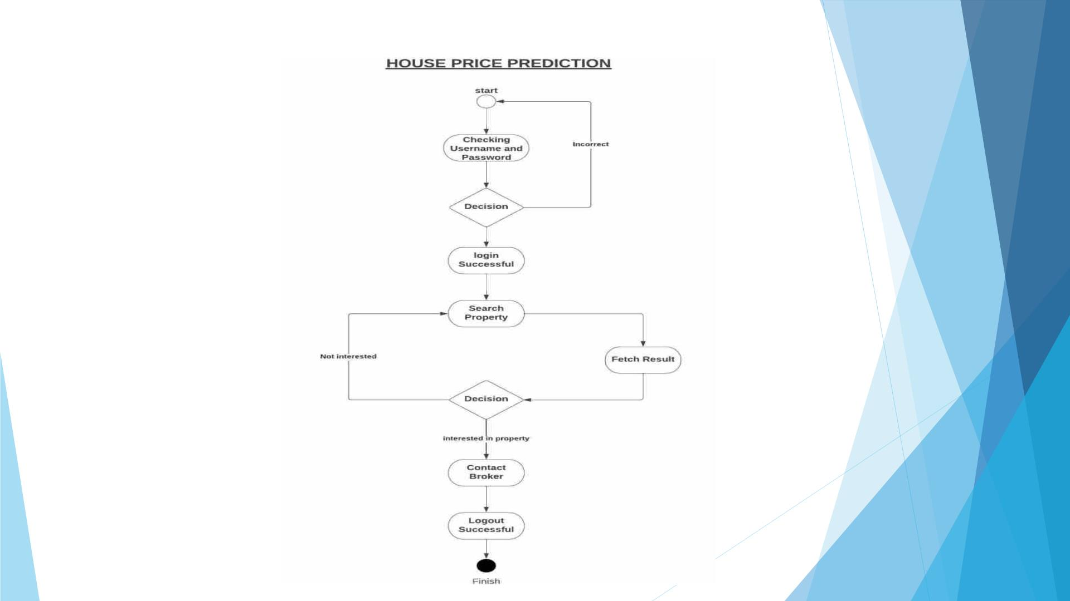
8. Block Diagriam

Slide 12
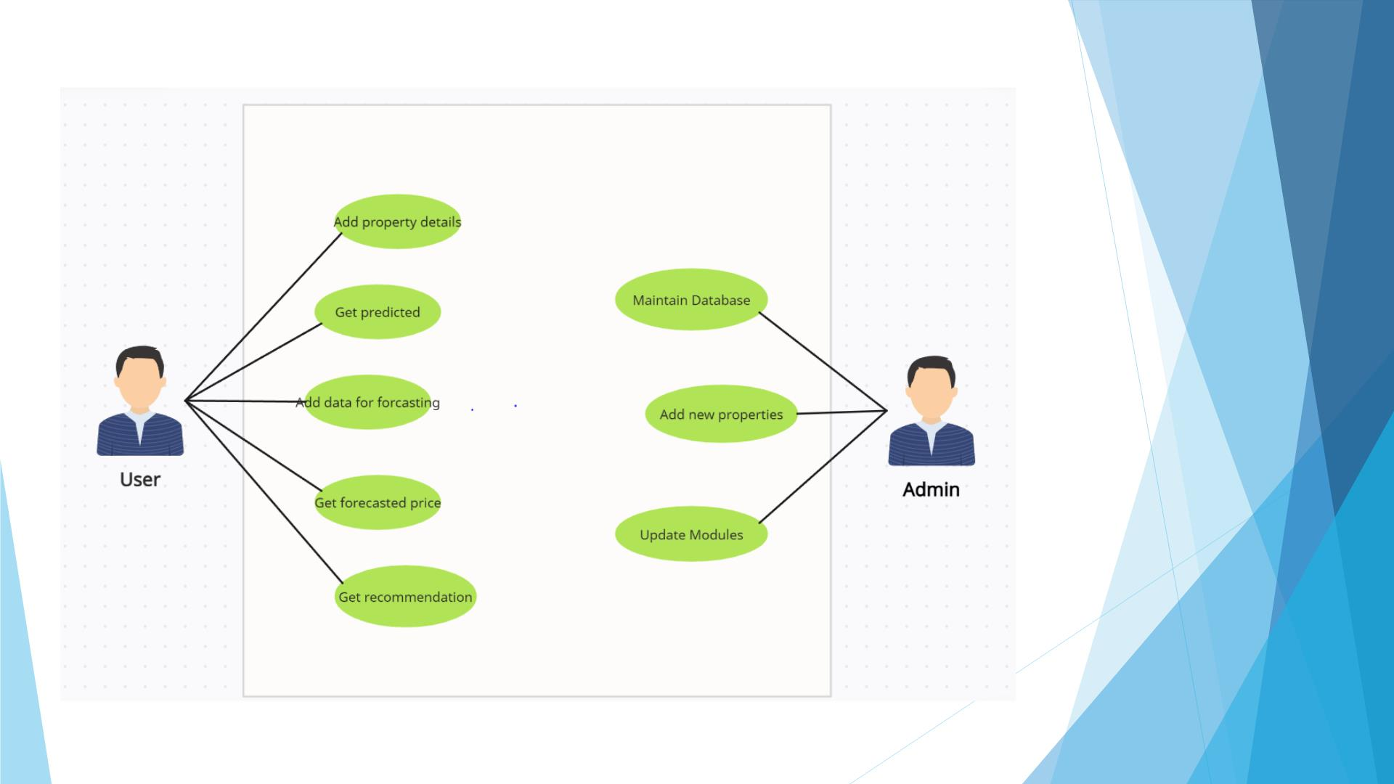
9. Use Case Diagram

Slide 13
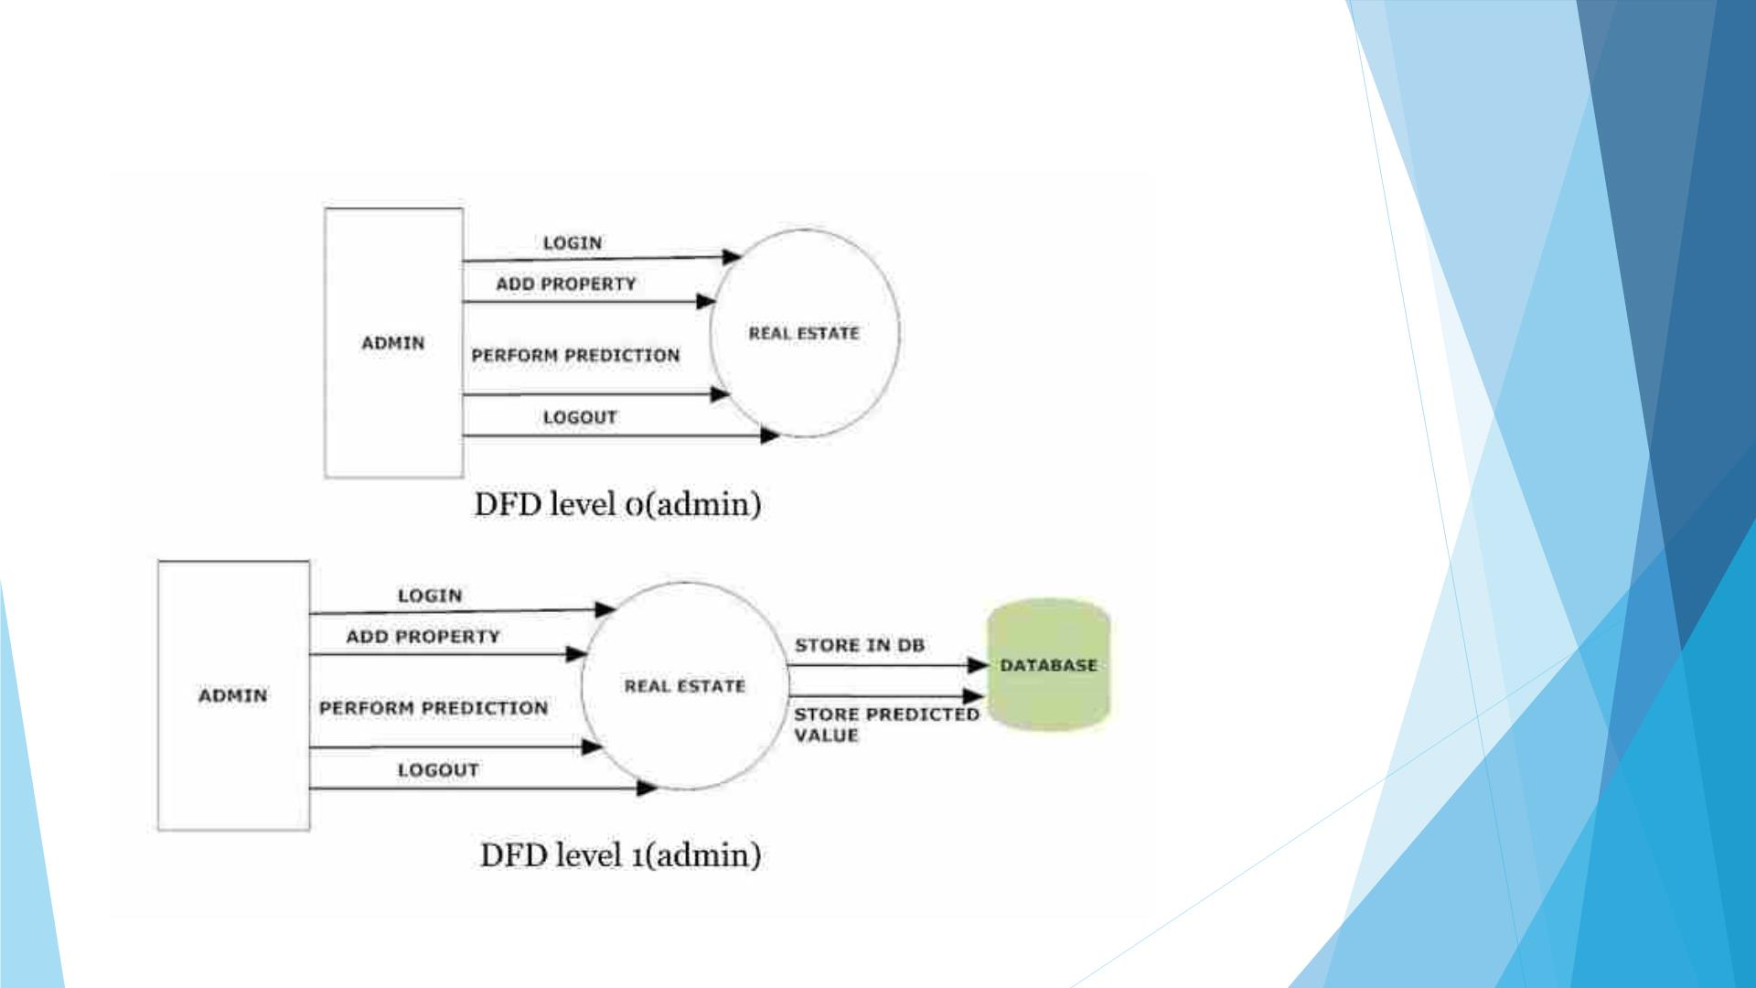
9b. Dataflow Diagram

Slide 14
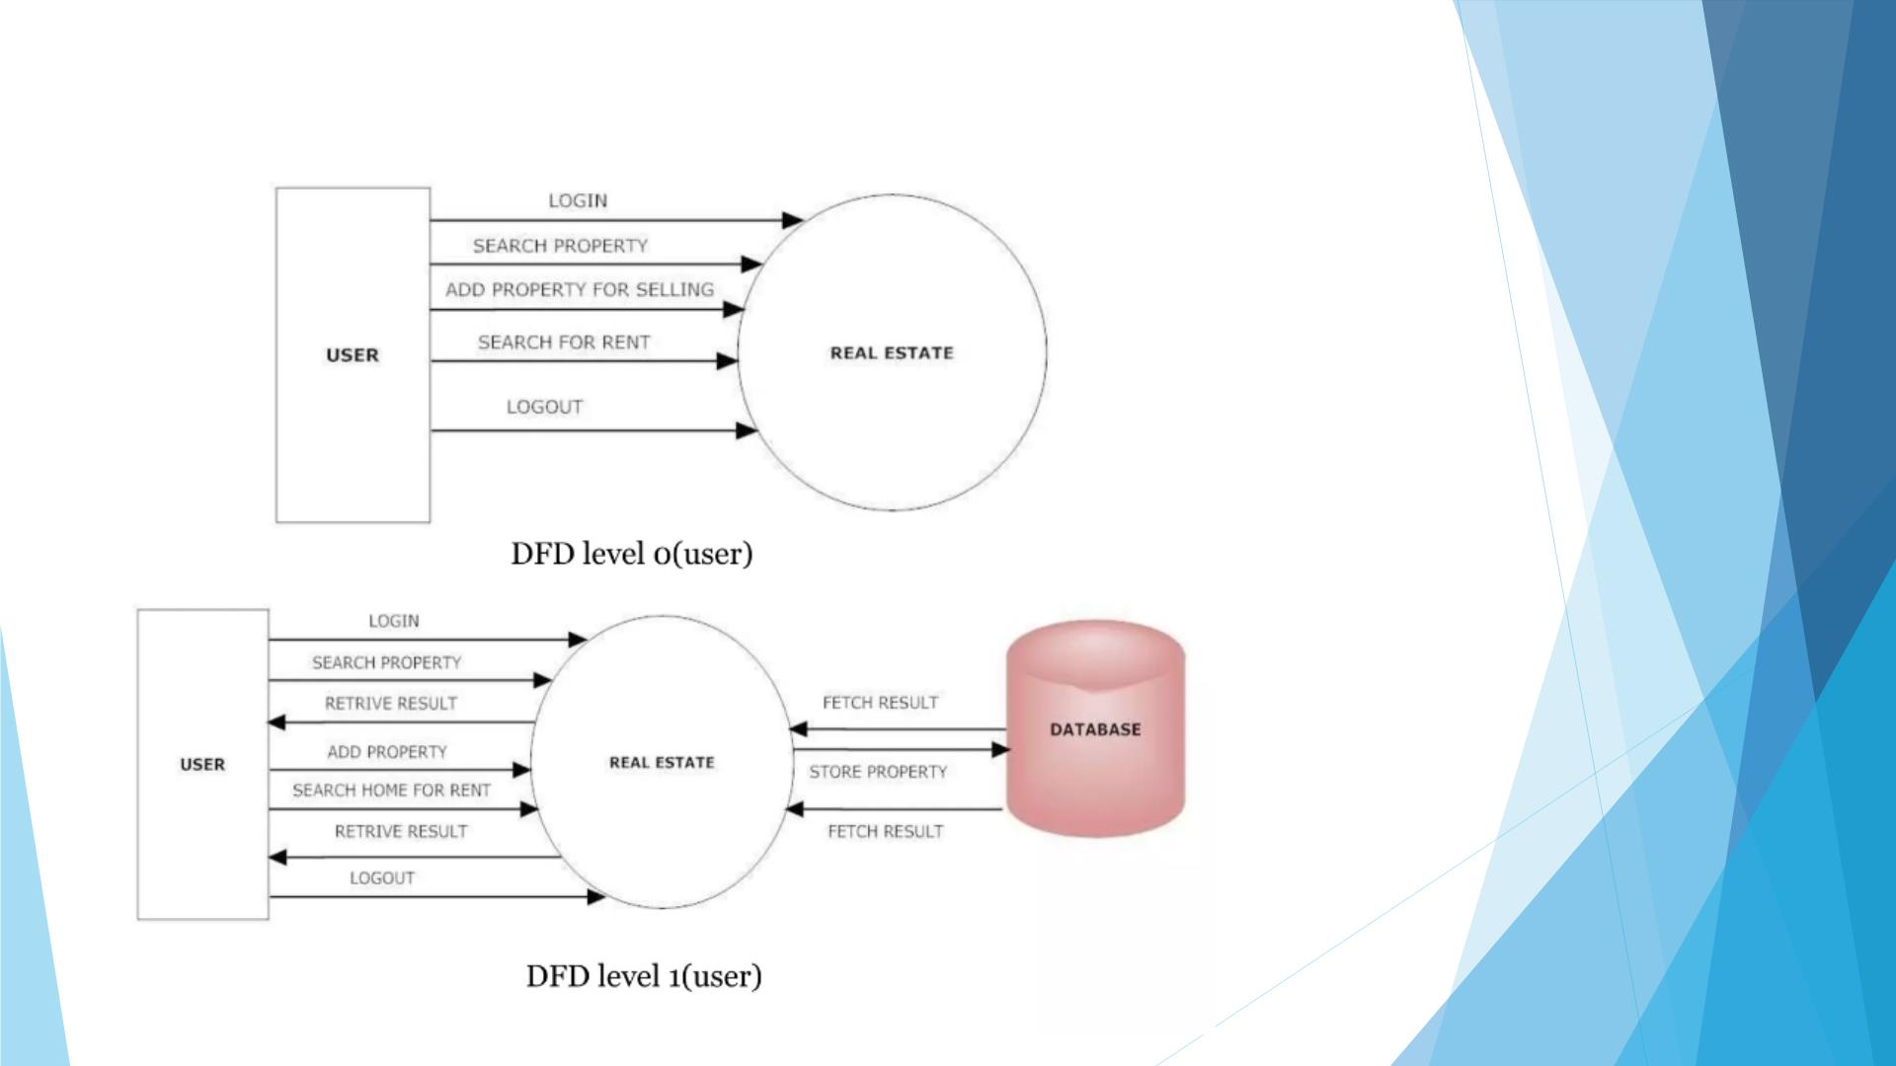
9c. Dataflow Diagram

Slide 15

10. Technology Stack
◆ Web application built on
HTML
CSS
Pandas
NumPy
XAMPP

Slide 16
11. Suggestion in Review - 1
◆ To Add different parameters for predicting the house price
◆ Change in The Literature Review
◆ Change in GUI

Slide 17
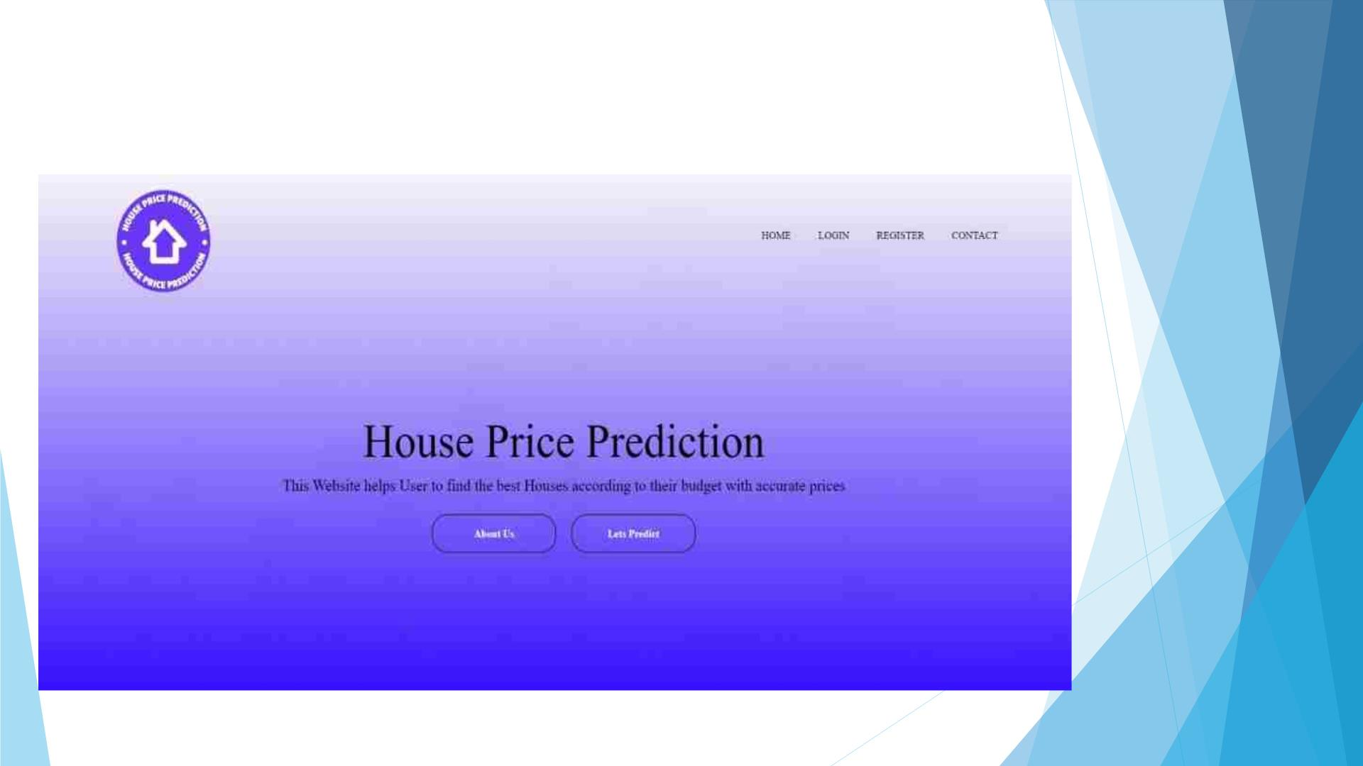
12. Result and Discussion

Slide 18


Slide 19
13. Conclusion and Future Scope
◆ The house price prediction app has the potential to be a useful tool for
both buyers and sellers in the real estate market.
◆ It could provide accurate estimates of house prices based on relevant
features, helping buyers make informed decisions and sellers set
appropriate prices.
◆ In terms of future scope, there are several areas where the app could be
improved and expanded.
◆ Area for improvement could be to expand the app to include additional
data sources and features, such as crime rates or school district
information, to provide a more comprehensive view of the factors that
impact house prices.

Slide 20
References
◆ [1] S. Ahmed, M. N. Islam, A. Y. Hasan, and M. A. Hossain, "An Accurate and Transparent
House Price Prediction Model for Real Estate," in 2021 IEEE International Conference on Systems,
Man, and Cybernetics (SMC), 2021, pp. 4777-4783.
◆ [2] A. S. Bhalerao and S. R. Ghotkar, "Real Estate Price Prediction using Machine Learning," in
2019 3rd International Conference on Computing Methodologies and Communication (ICCMC),
2019, pp. 128-132.
◆ [3] M. O. Alqahtani, M. F. Alharthi, and N. Al-Twairesh, "House Price Prediction Using Machine
Learning Techniques," in 2021 IEEE International Conference on Computing, Electronics &
Communications Engineering (IEEE ICCECE), 2021, pp. 1-6.
◆ [4] T. T. Nguyen, T. V. Nguyen, and T. V. Le, "House Price Prediction using Machine Learning
Algorithms," in 2019 IEEE 11th International Conference on Knowledge and Systems Engineering
(KSE), 2019, pp. 338-343.
◆ [5] Y. Zhang, J. Ma, J. Wei, and Y. Wang, "Research on House Price Prediction Based on
Improved Random Forest Algorithm," in 2020 3rd International Conference on Artificial
Intelligence and Big Data (ICAIBD), 2020, pp. 316-319.

Slide 21


